Slide 1
Object Oriented Analysis and Design with UML
(c) Copyright 2016 by Dyer Consulting
Quebec, Canada
All rights reserved

Slide 2
Class Diagrams - The Essentials
Introduction
The Class Diagram
Perspectives
Associations
Navigability
Attributes
Difference Between Associations and Attributes
Operations
Generalization
Abstract Classes
Identifying Generalization Relationships
Constraint Rules

Slide 3
Class Diagrams – Essentials
Class diagram technique has become central within object-oriented methods
Class diagram is also subject to the greatest range of modeling concepts

Slide 4
The Class Diagram
Describes the types of objects in the systems and the various kinds of static relationships that exist among them
Two principle kinds of static relationships
Associations
Subtypes

Slide 5
Static Relationships
Associations
E.g. Customer may rent a number of videos
Subtypes
E.g. Nurse is a kind of person

Slide 6
Class Relationships
OO methods often use different and conflicting terminology for these concepts
Three perspectives you can use in drawing class diagrams
Conceptual
Specification
Implementation

Slide 7
Conceptual (Perspective)
Draw a diagram that represents the concepts in the domain under study
Concepts will naturally relate to the classes that implement them but often no direct mapping
Should be drawn with little or no regard for the software that might implement it (language independent)

Slide 8
Specification (Perspective)
Looking at software, interfaces, not implementation
Looking at types rather than classes

Slide 9
Implementation (Perspective)
Have classes
Most often used perspective

Slide 10
Associations and Perspectives
Represent relationships between instances of classes ( a person works for a company, a company has a number of offices)
Interpret associations somewhat differently depending on the perspective

Slide 11
Conceptual
Associations represent conceptual relationships between classes
Order has to come from a single Customer and that a Customer may make several Orders over time
Each Order has several Order Lines, each of which refers to a single product
Draw Order, Customer, Order line item and specification (see Simple Class diagram below)

Slide 12
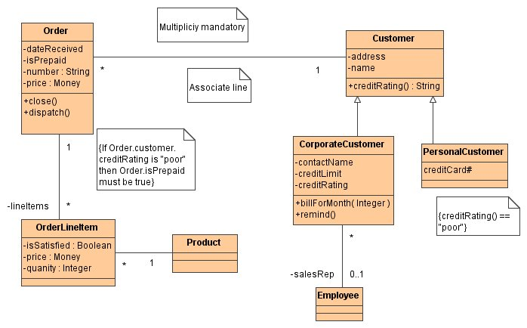

Slide 13
Roles and Associations
Each association has 2 roles
Each role is a direction on the association
A role can be explicitly named with a label (E.g. Line items)

Slide 14
Role Names and Multiplicity
If no role name, name the role after the target class
A role has multiplicity (indication of how many objects may participate in the given relationship
"*" between Customer and Order indicates that a Customer may have many Orders associated with it; the "1" indicates that an Order comes from only one Customer

Slide 15
Multiplicity Values
1 A is always associated with one B
1..* A is associated with one or more B
0..1 A is associated with zero or one B
* A is associated with zero, one or more B

Slide 16
Specification
Associations represent responsibilities
See the Simple Class Diagram
Implies there are one or more methods associated with Customer that will tell me what orders a given Customer has made
Methods within Order that will tell which Customer places a given Order and what Line Items comprise an Order

Slide 17
Set and Get Methods
If standard conventions for naming "query" methods, can be inferred from the diagram
E.g.
Single-valued relationships are implemented with a method that returns the related object
Multi-valued relationship are implemented with an enumeration (iterator) into a collection of the related objects

Slide 18
Public Interface
Infer the following interface for an Order class (in Java)
class Order {
public Customer customer();
//Enumeration of order lines
public Enumeration orderLines();
...
}

Slide 19
Responsibilities
Also implies responsibility for updating the relationship (relating the order to the Customer)
In a specification diagram responsibilities do not imply data structure
Cannot and should not be able to tell whether the Order class actually contains a pointer to Order, or whether the Order class fulfills its responsibility by executing some selection code that asks each customer if it refers to a given Order
Diagram indicates only the interface, nothing more

Slide 20
Implementation
From Implementation perspective, now imply that there are pointers in both directions between the related classes
Diagram would now say that Order has a field that is a collection of pointers to Order Lines and also has a pointer to Customer

Slide 21
Example Implementation Perspective
Class Order { private Customer _customer; private Vector _orderLines; ...
}
class Customer { private Vector _orders; ...
}

Slide 22
Navigability
Arrows on association lines indicate navigability
See Class Diagram with Navigability (below)
In Specification Model it indicates that Order has a responsibility to tell you which Customer it is for, but a Customer has no corresponding ability to tell you which Order(s) it has

Slide 23
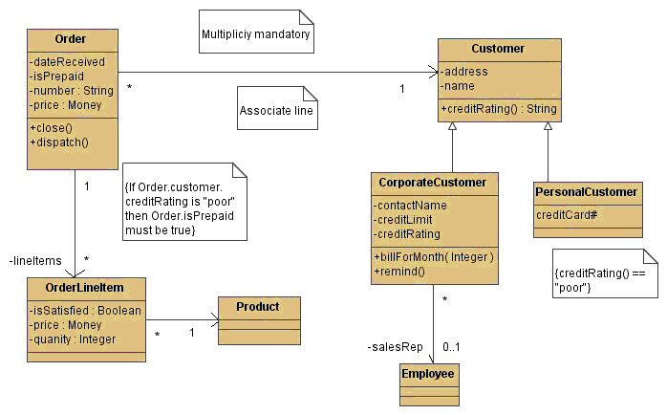

Slide 24
Navigability …
In Implementation it indicates that Order contains a pointer to Customer but Customer would not point to Order

Slide 25
Navigability - Directions
Navigability is an important part of implementation and specification diagrams
Navigability in only one direction is called a unidirectional association
Navigability in both directions is a bi-directional association

Slide 26
Navigability Defaults
In UML associations with no arrows indicate either the navigability is unknown, or the association is bi-directional
Traditional data modelers name an association using a verb phrase so that the relationship can be used in a sentence
Most OO modelers prefer to use a non to name one or the other of the roles (corresponds better to responsibilities and operations)

Slide 27
Attributes
Attributes are similar to associations
Conceptual
A Customer's name attribute indicates that Customers have names
Specification
Indicates that a Customer object can tell you its name and has some way of setting a name

Slide 28
Attributes
Implementation
Customer has a field (instance variable or data member) for its name
Notation for an attributes can show the attribute's name, type, and default value

Slide 29
UML syntax
visibility name:type = defaultValue

Slide 30
Difference Between Association and Attribute
Conceptual model - none, just another kind of notation
Attributes are always single-valued
Diagram does not indicate whether an attribute is optional or mandatory
Difference occurs at the Specification and Implementation level

Slide 31
Associations and Attributes
Attributes imply navigability from the type to the attribute only
Implied that the type contains solely its own copy of the attribute object (attribute has value rather than reference semantics, covered later)
Best to think of attributes as small, simple classes, such as strings, dates, money object, non-object values such as int and real

Slide 32
Operations
Processes that a class knows to carry out
Correspond to the methods on a class

Slide 33
Operations – Specification Level
Operations correspond to public methods on a type (normally do not show operations that manipulate attributes, should be inferred)
You may want to indicate whether a given attribute is read-only or immutable (its value never changes)

Slide 34
Operations - Implementation
May show private and protected operations as well as public
May be expressed in a language dependant manner

Slide 35
UML syntax
visibility name (parameter-list):return-type-expression {property-string} WHERE: visibility + (public), # (protected), - (private) name a string parameter-list contains (optional) arguments whose
syntax is the same as that for attributes return-type-expression
optional, language-dependent specification property-string indicates property values that apply to the
given operation

Slide 36
Operations – Conceptual Model
Operations should not attempt to specify the interface of a class
Should indicate the principal responsibilities of that class (use CRC cards)
Useful to distinguish between operations that change the state of a class and those that don't (query)

Slide 37
Operations – Conceptual Model …
Query gets the value from a class without changing the class' observable state
Observable state - the state of an object you can determine from its associated queries
Operations that change observable state are called modifiers
"getting method" and "setting method", common methods for setting and retrieving attributes (get and set pattern)

Slide 38
Distinction Between Operation and Method
Operation is something that is invoked on an object (the procedure call)
Method is the body of procedure
When two methods are different for the same operation you have polymorphism

Slide 39
Operation and Method
If you have a supertype with 3 subtypes, each overrides the supertype
You have one operation and four methods that implement it
Also called "method call" or "method declaration" and "method body"

Slide 40
Generalization
Involves factoring out the commonality from types
Relationship between a class and its specialized versions
IS-A, KIND-OF relationships
generalization vrs Specialization
Superclass (base) and subclass

Slide 41
Generalization …
A class can share attributes and operations of other classes using the generalization relationship
Each subclass inherits features from its superclass
Can add more attributes and operations, Personal and Corporate Customers of a business

Slide 42
Generalization …
They have differences but also many similarities
Similarities can be placed in a general Customer class (the supertype)
Personal Customer and Corporate Customer as subtypes

Slide 43
Generalization Conceptual
Corporate Customer is a subtype of Customer if all instances of Corporate Customer are also, by definition, instances of Customer
A Corporate Customer is a special type of Customer (inheritance of associations, attributes, operations)

Slide 44
Generalization Specification
Interface of the subtype must include all elements from the interface of the supertype
Subtype's interface is said to conform to the supertype's interface
Should be able to substitute Corporate Customer within any code that requires a Customer, and everything should work fine

Slide 45
Generalization Specification …
Corporate Customer may respond differently to certain commands from another Customer (polymorphism) but the caller should not need to worry about the difference

Slide 46
Generalization Implementation
Associated with inheritance in programming languages
subclass inherits all the methods and fields of the superclass and may override inherited methods

Slide 47
Overriding Features from a Superclass
Why? to be more specific
Subclass can override the implementation of an operation in its superclass
The operation defined in subclass should have the same name and signature
Subclass can override the default values of attributes defined in its superclass

Slide 48
Rational for overriding
For extension
new operation is almost the same except it adds additional behavior that only affects new attributes of the subclass
For restriction
new operation restricts the feature protocol, such as tightening the types of arguments
For optimization
new implementation taking advantage of new attributes and/or algorithms (signature remains the same)

Slide 49
Abstract Classes
Has no DIRECT instances
Usually models a generic concept
In real-world, each of its instance can always be further classified into one of its subclasses
Helps organize the class hierarchy Contains abstract operations whose implementation must be supplied by subclasses
Dictates a generic public interface
Only concrete class can have direct instants

Slide 50
Identifying Generalization Relationships
Two approaches
TOP DOWN
BOTTOM UP

Slide 51
Top Down
Can you break an existing class into more specialized sublcasses?
Go thru your problem statement, look for adjectives on nouns Part-time employee, full-time employee, pop-up menu, IBM Nurds
Use you domain knowledge to find enumerated subclasses Checking account, saving account
Subclasses may be represented as attribute with different values Married person, single person

Slide 52
Bottom Up
Can you generalize the common aspects of some existing classes into a superclass?
Go thru you CD cards, look for classes with some similar attributes, collaborators, and responsibilities RemoteTransaction and CashierTransaction ( common portion can be generalized to Transaction )

Slide 53
Constraint Rules
Drawing class diagrams is indicating constraints
Show constraint on ORDER, multiplicity indicates that Order can be placed only by a single Customer etc.
Association, attribute, and generalization specify important constraints but not all Constraints need to be captured

Slide 54
Constraint Syntax
UML - no strict syntax other than putting them inside curly braces ({})
Could use informal English
Restricts the values an entity can assume

Slide 55
Constraints …
Runtime errors are often the result that some necessary constraints are not included in your object model; consequently they are not checked in the implementation
{1 <= day <= 31} {1 <= month <= 12} {1980 < year <= 2100}

